Slide 1
Some revision notes
(if you ONLY study this is would NOT be enough)
Chs 13 and 15
(relevant to both open and MC questions)
Self-study
Slides by Prof C Rootman

Slide 2
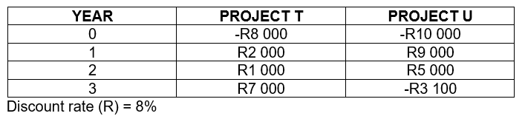
Chapter 13 Capital budgeting example
[Remember: discount rate = required rate of return] Evaluate projects by calculating NPVs and IRRs

Slide 3
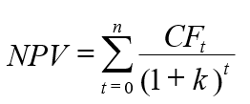
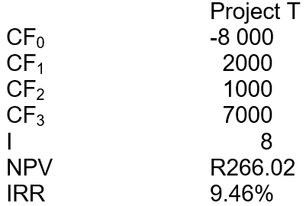
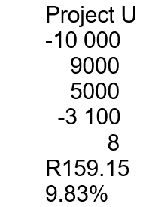
Equation Answer Accept or reject? Motivate
Both T and U acceptable Why? NPVs > 0 IRRs > RRR of 8%

Slide 4
If mutually exclusive? If based on NPV… Project T, why? If based on IRR… Project U, why? Could also get questions on cross-over rate Also questions on the other investment criteria/techniques: payback periods, ARR, PI Easy marks…study them all! DPB of Project T…

Slide 5
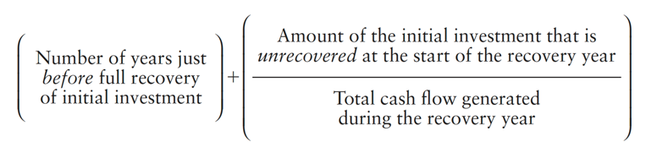
DPB of Project T
 | Year 0 | Year 1 | Year 2 | Year 3
CF | -8 000 | 2 000 | 1 000 | 7 000
DCF |  | 1 851.85 | 857.34 | 5 556.83
Total | -8 000 | -6 148.15 | -5 290.81 | 266.02
= 2 + (5 290.81 / 5 556.83) = 2.95 years
Accept or reject Project T based on DPB? Depends on?

Slide 6
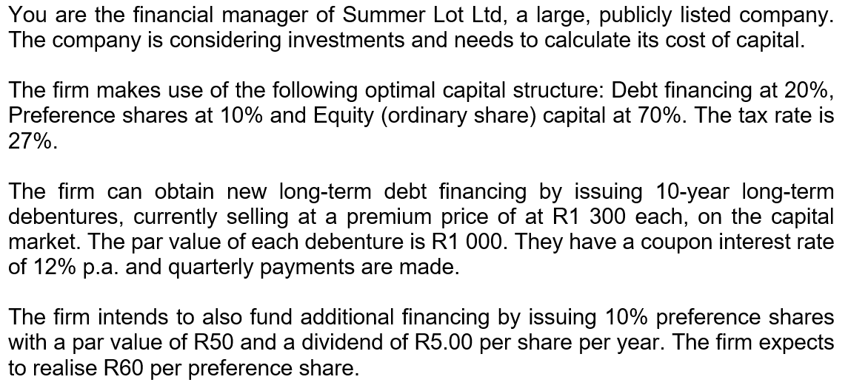
Chapter 15 Cost of capital example

Slide 7
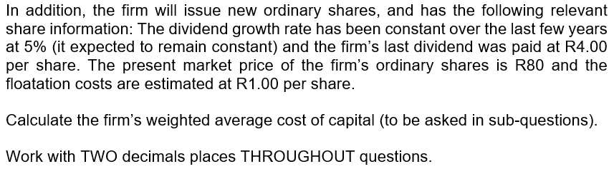
To calculate WACC we need the weights (%s) of capital sources and costs of the capital sources We have the weights in this example! (What is you didn’t have the weights? How would you calculate it?) What if you have the R values of the capital sources? Do you know how to you calculate the weights?

Slide 8
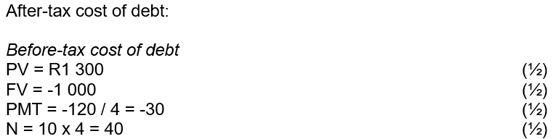


Slide 9



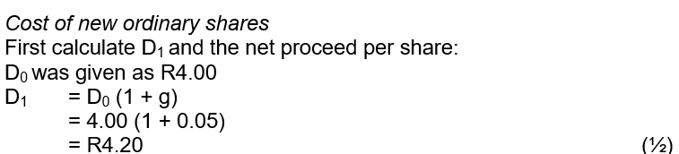

But now we have flotation costs, so use net value
But now we have flotation costs, so use net value
Check… k_{i} < k_{p} < k_{n} Is this the case? Yes!

Slide 10
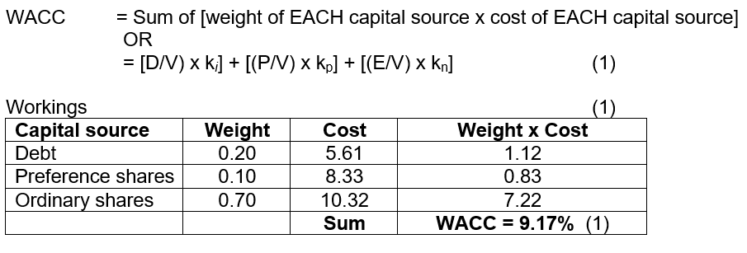
WACC = [(D/V) x k_{i}] + [(P/V) x k_{p}] + [(E/V) x k_{n}]
Quickly look at k_{n} or k_{s} again (the cost of equity). What if you didn’t have the dividend info? If market-related info is given…you would use the SML to calculate the cost of equity

Slide 11
Happy studying!
More revision notes and examples: SG, Funda (remember Chs 14 and 16), textbook, etc.
Remember to use the overview slides as well as the Exam guidelines & layout that were discussed in class, etc.

